Slide 1

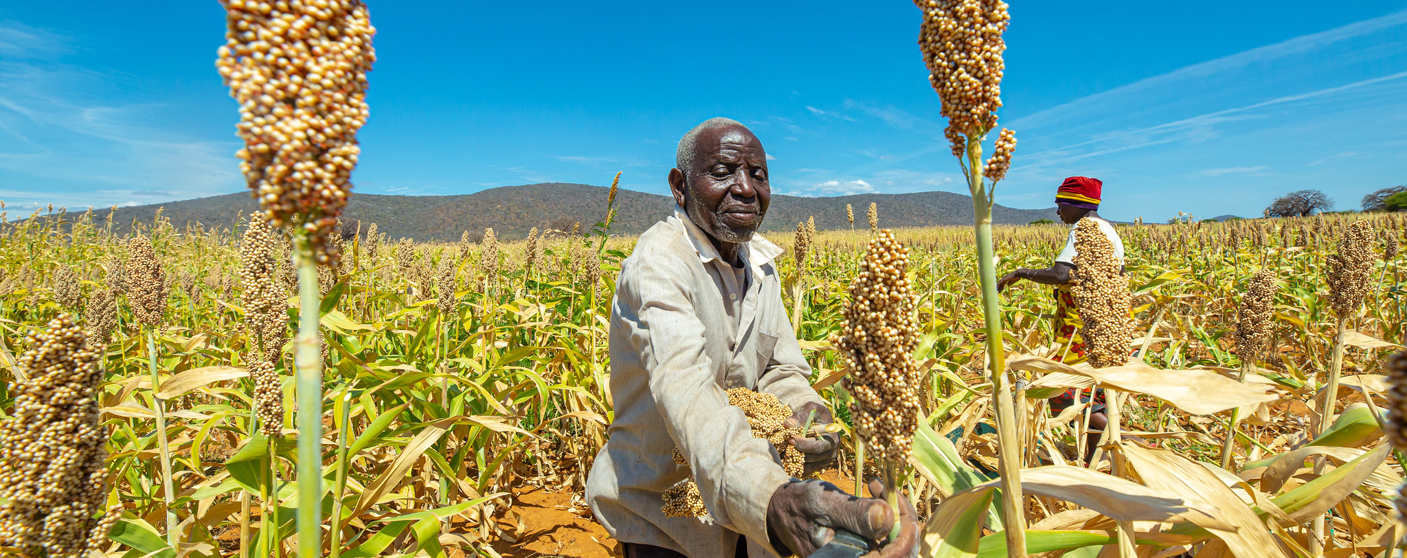

Targeting Strategy – Decision Points Presentation to the [Country office] Targeting Working Group
© WFP/Gabriela Vivacqua
Date

Slide 2
Note: free to change the colours to any of the WFP Corporate colours (see box to the left). Preselected photo link is in slide 1. The agenda on the right is a table.
01 | Targeting Strategy Structure
02 | Decision 1: [Insert]
03 | Decision 2: [Insert]
04 | …
05 | Next Steps and Q&A
©WFP/Rein Skullerud

Slide 3
Note: free to change the colours to any of the WFP Corporate colours (see box to the left).
Targeting Strategy Structure

Slide 4
Note: free to change the colours to any of the WFP Corporate colours (see box to the left).
Content of the Targeting Strategy
Background and CSP Overview
In which context are WFP programmes implemented?
Programmatic Objectives
What vulnerability framework does each programme use?
Partnerships
How do programmes from partners interact with WFP’s?
Can targeting build on synergies in vulnerability frameworks?
Coordination Mechanisms
Which coordination mechanism (internal/external) will be used to ensure decisions are in line with the strategy?
Step 1: Needs and Context Analysis (high-level)
Which data will be used to design and update the targeting?
Step 2: Targeting Design (high-level)
Which targeting method seems most appropriate (per programme)?
How will we engage with communities for the design?
Step 3: Implementation (high-level)
How will we register and verify beneficiaries for our programmes?
How will we engage with communities (CFM, appeals)?
Step 4: Monitoring (high-level)
How will we monitor targeting errors and targeting risks?
Targeting Risk Management
Who are the stakeholders interested in our targeting decisions?
What are the risks around the proposed targeting approaches?
Targeting Assurance Roadmap
Which improvements will need to be integrated to our current targeting?

Slide 5
Note: free to change the colours to any of the WFP Corporate colours (see box to the left).
Decision #1: [Insert]

Slide 6
Note: free to change the colours to any of the WFP Corporate colours (see box to the left).
Next Steps and Q&A

Slide 7
Next Steps
 | Month |  |  |  |  |  |  |  |  |  |  |  |  |  |  |  |  |  |  |  | Month
 | Day | Day | Day | Day | Day | Day | Day | Day | Day | Day | Day | Day | Day | Day | Day | Day | Day | Day | Day | Day | Day | Day | Day | Day | Day
Targeting Strategy
1. Desk review of documentation
2. Interview management on objectives
3. Interview SO and activity managers
4. Field visits
5. Interview cross-cutting experts
6. Presentation of priorities/gaps to TWG
7. Draft integrated framework for targeting
8. Presentation of framework to TWG
9. Consultations with external stakeholders
10. Drafting of the targeting strategy
11. First review by TWG
12. Review of the targeting strategy
13. Presentation of open questions to TWG
14. Review of the targeting strategy
15. Endorsement and dissemination

Slide 8
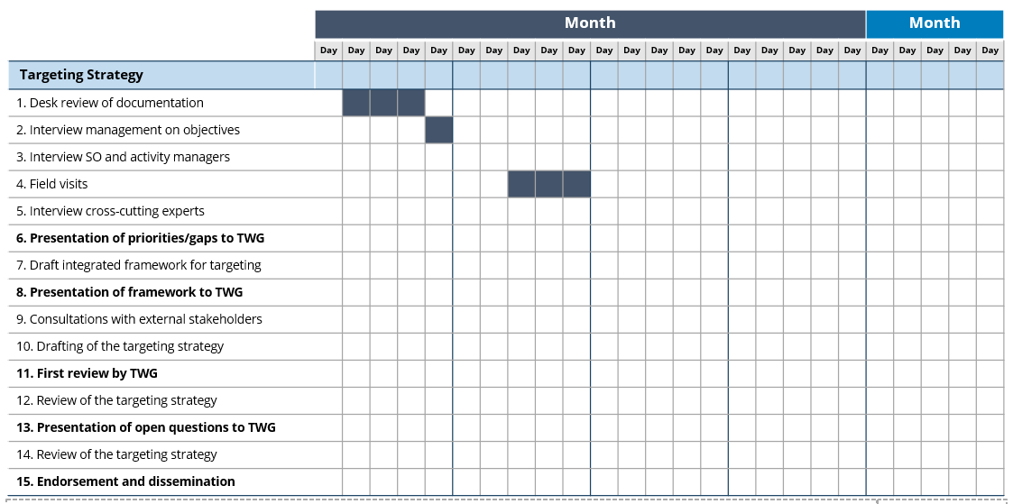
How to update the next steps
→ Identify someone who will keep an eye on the progress and follow-ups
→ 2-3 months might be needed to go through all the steps
Add months, days and color the appropriate boxes to create a Gantt Chart
Steps can be adjusted to the context of the CO

Slide 9
Note: free to change the colours to any of the WFP Corporate colours (see box to the left).
Thank you!

